Slide 1



ANALYSIS IN INDIA
Presented By
Akhyata Moharana
Md. Kamran
Roshni Patidar
Sumidha Kumari Prasad

Slide 2

Project Overview
COVID-19 Pandemic:
A global health crisis caused by the novel coronavirus, affecting millions of lives, economies, and healthcare systems worldwide.
Comprehensive analysis of India's COVID-19 data revealed varying impacts across states and districts and analyzing data and trends to uncover valuable insights.
Our project utilized Python for extracting COVID-19 data from JSON files and for cleaning the data. SQL for efficient data processing and Excel to create dynamic dashboards, providing a comprehensive and interactive view of the pandemic's impact.

Slide 3
Key Project Phases
Data Extraction:
Initially, we retrieved COVID-19 data from a JSON format using Python
Data Cleaning:
Cleaned, validated, and formatted the data, handling missing values and outliers appropriately.
Data Storage:
We stored the cleaned data in MYSQL database, enabling efficient data retrieval for analysis.
Visualization:
Excel was used to create insightful and interactive dashboards.
Insights Generation:
We derived valuable insights, including vaccination rates, testing trends, and disease spread patterns.
GitHub Documentation:
A detailed project description was crafted to make the project accessible to a wider audience.
Presentation Preparation:
Lastly, we organized our insights and findings into a presentation, ensuring that key takeaways were highlighted effectively.

Slide 4
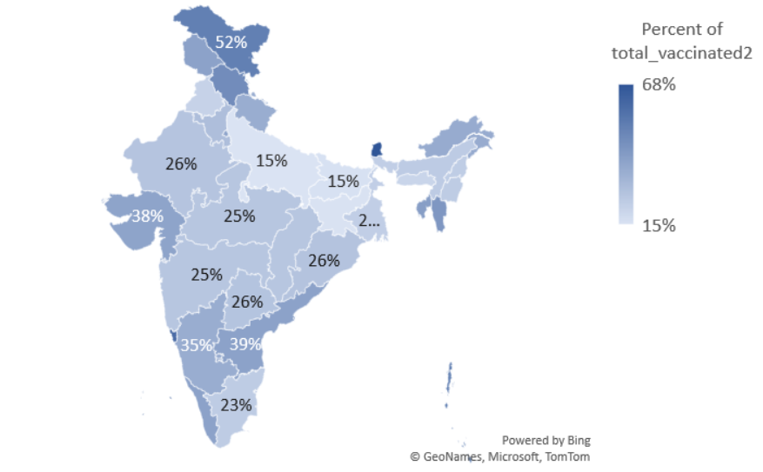
State-wise COVID-19 Vaccination Coverage as a Percentage of Total Population
Ladakh leads with 52% of the total population having received the 2nd dose of vaccination.

Slide 5
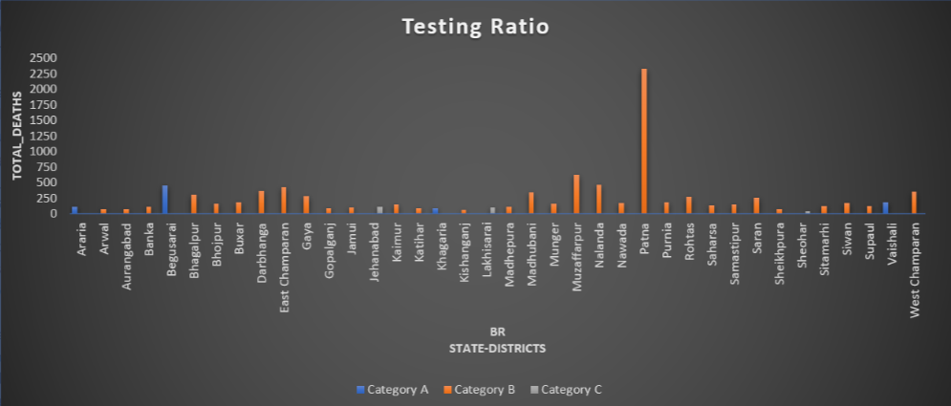
Analyzing COVID-19 Testing Ratios Across Districts of Bihar
testing ratio(tr) = (number of tests done) / (population)
Category A: 0.05 ≤ tr ≤ 0.1
Category B: 0.1 < tr ≤ 0.3
Category C: 0.3 < tr ≤ 0.5
Category D: 0.5 < tr ≤ 0.75
Category E: 0.75 < tr ≤ 1.0
The district of Patna in Bihar, categorized under Category B, shows the highest testing ratio.

Slide 6
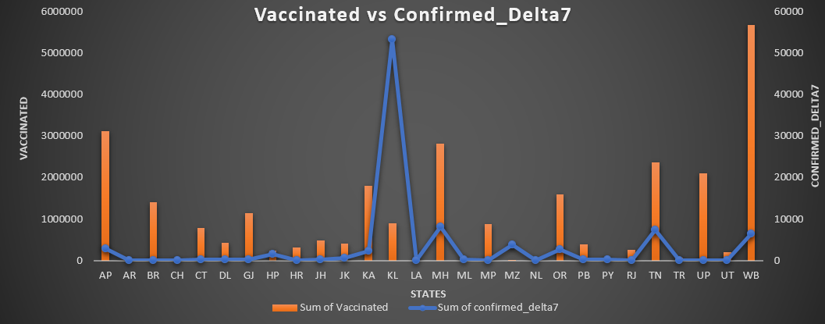
Analyzing COVID-19 Vaccinated and Confirmed Delta7 Cases Trends Across States
Kerala Faces Highest Confirmed Delta7 Cases.
West Bengal Leads in Total Vaccinated.

Slide 7
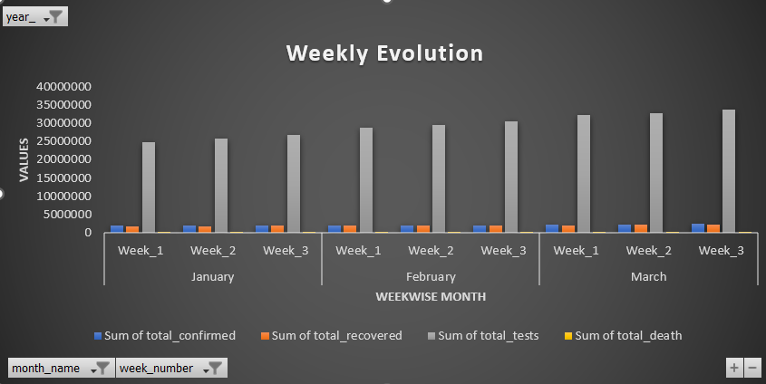
Weekly Evolution
Week 3 of each month shows the highest test done.

Slide 8
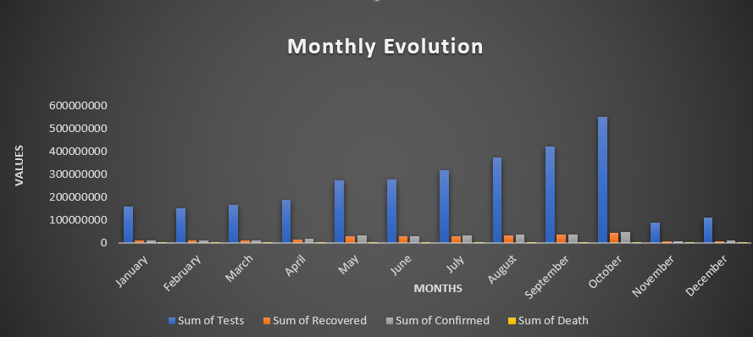
Monthly Evolution
The highest number of tests were conducted in the month of October.

Slide 9
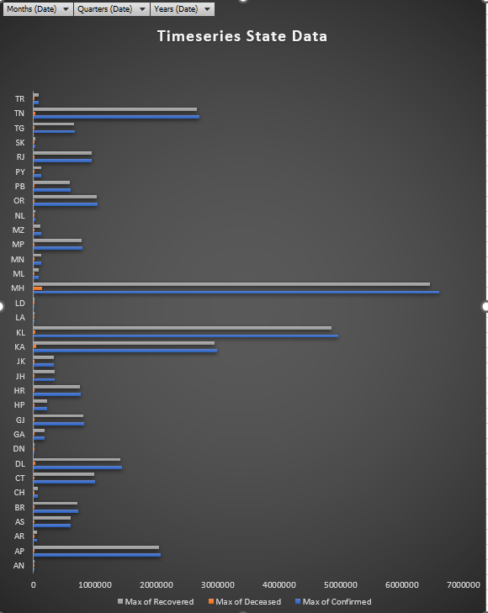
Time series State Data
Maharashtra has reported the highest number of confirmed COVID-19 cases, the highest number of recoveries, and the highest number of deceased individuals.

Slide 10
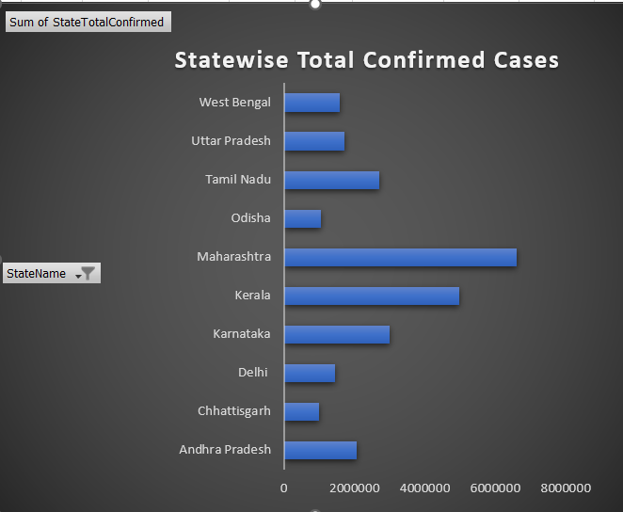
COVID-19 Total Confirmed Cases by State
Maharashtra Reports the Highest Number of Confirmed COVID-19 Cases

Slide 11
Challenges and Learnings
Data Extraction from JSON:
This process involves parsing structured JSON data to access, manipulate, and analyze valuable information
Data Cleaning and Pre-Processing:
Real-world data is inconsistent and unorganized.
Creating an Interactive Dashboard:
Creating an interactive dashboard to understand data effectively.

Slide 12



